Slide 1
ABU DHABI PERMITTING & LOCAL AUTHORITIES PROCESS. 2026

Slide 2
1. Introduction
2. Dorsch Scope of Work
3. Masterplan Approvals & NOC Guide
4. Building Permit Strategy
5. Important General Notes
6. Conclusion

Slide 3


INTRODUCTION
This Presentation outlines the comprehensive Masterplan Approvals & NOC Guide – Comprehensive Protocol for CMP, DMP, Critical Control Points, and Multi-Agency Clearances in the UAE.
It Outlines the permitting strategy for obtaining building approval from Abu Dhabi Municipality.
Aligned with the official Building Permit Guidelines issued by the Department of Municipalities and Transport (DMT).
Ensures alignment with construction regulations and standards in Abu Dhabi.
The DMT guidelines act as the legal and procedural reference for all construction-related services in Abu Dhabi.
Alignment between Infrastructure and Building Permit approvals, identifying key approvals and NOCs that must be obtained in advance to support the Building Permit process.

Slide 4

DORSCH SCOPE OF WORK
Hold regular meetings and maintain coordination with authorities and design teams.
Review drawings to ensure compliance with local regulations and codes.
Obtain NOCs from all relevant entities.
Prepare an authority program covering submission, review, and approval stages.
Maintain an Authorities Approvals Tracker.
Share deliverables list with the design team.
Develop an authority flowchart and AOR dashboard, including submission and approval records.

Slide 5
MASTERPLAN APPROVALS & NOC GUIDE
DEPARTMENT OF MUNUCIPALITIES AND TRANSPORTATION (DMT)

Slide 6
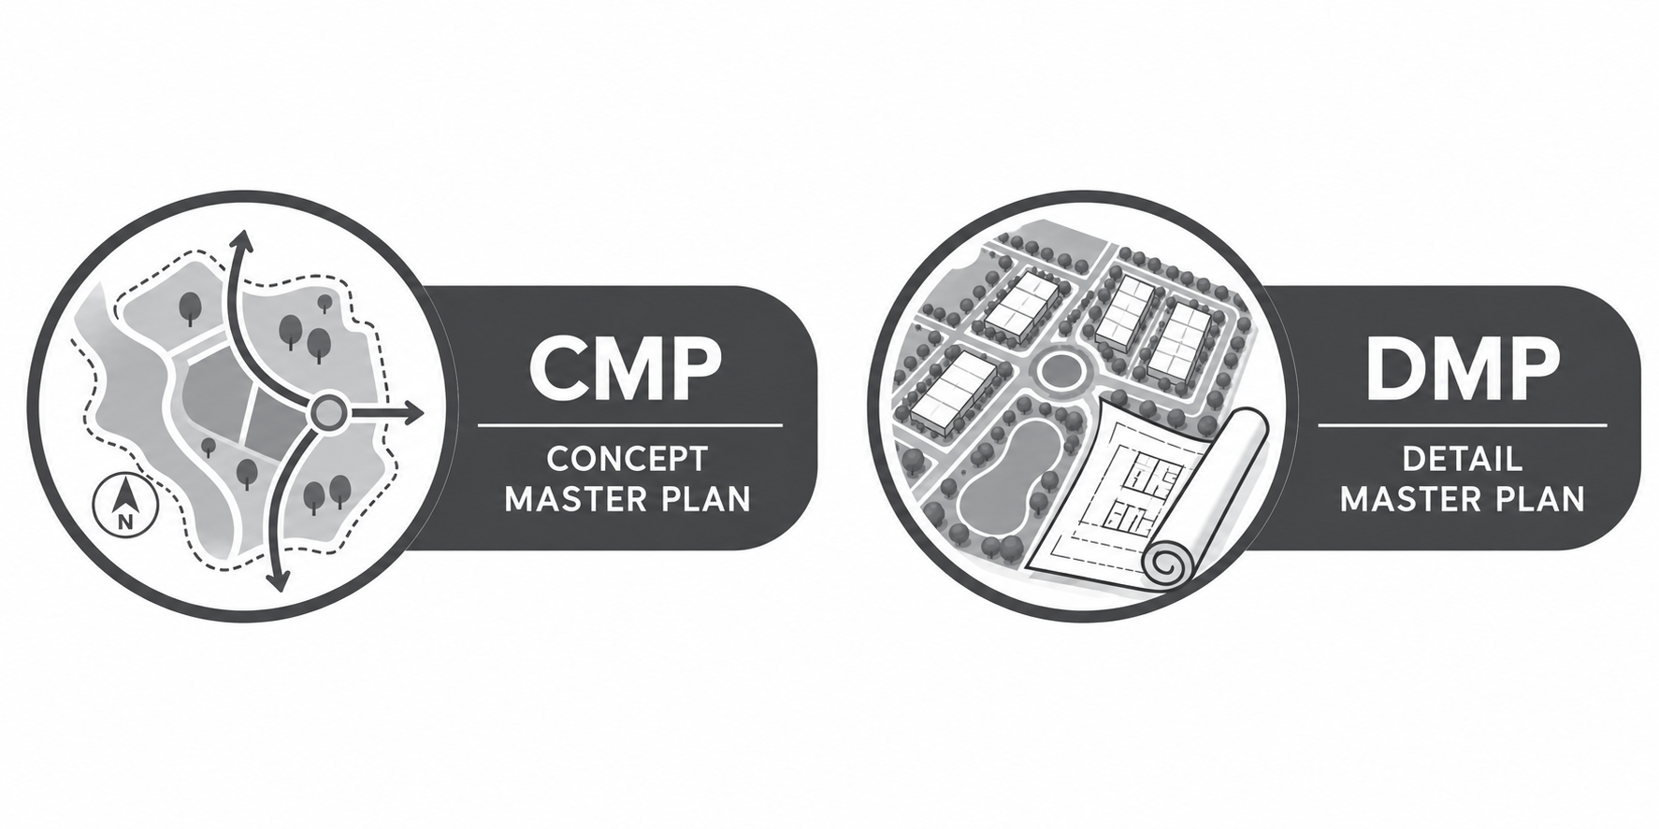
CONCEPT MASTERPLAN (CMP) & DETAILED MASTERPLAN (DMP)
Establishes the macro-level spatial framework, land-use distribution, gross floor area (GFA) metrics, and regional transport integration.
High-level density allocations
Primary access corridors
Environmental & zoning boundaries
Translates the CMP into parcel-level designations, precise right-of-way (ROW) geometries, utility corridors, and phase-by-phase execution schedules.
Parcel demarcation and lot sizing
Exact utility corridor reservations
Detailed phasing alignment

Slide 7
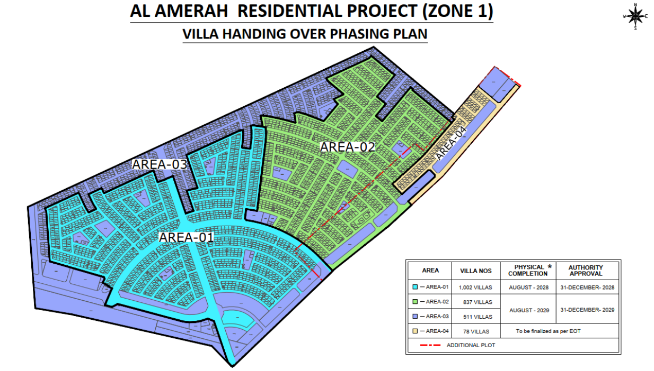
MASTERPLAN APPROVAL ECOSYSTEM
Masterplan infrastructure approval requires synchronized navigation across multiple decentralized regulatory bodies before any detailed engineering design can commence.
DMT Infrastructure & Public Realm: Core approving authority for overall layout and spatial compliance.
Transport Planning & Road Asset Management: Governing road networks, TIS, and connectivity.
Utility Providers: TAQA (Power), Water Authority, TSE, and Telecom providers (Etisalat/du).
Civil Defence & Environment Authority: Ensuring safety compliance and environmental regulations.

Slide 8


PRIMARY AUTHORITY REQUIREMENTS
Governs
Road layouts, Horizontal/vertical alignments,
Traffic impact studies (TIS),
Stormwater drainage capacity matching.
Requires
Detailed load schedules (kVA),
Demand calculations,
Diversity factors,
Optimal substation allocation strategies.
Mandates
potable water pressure analysis,
Fire flow requirements,
TSE irrigation calculations,
Duct bank fiber routing.
DMT/ADM
TAQA Distribution
Utilities & Telecom

Slide 9
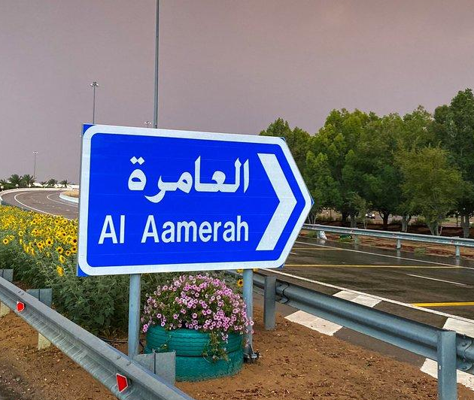
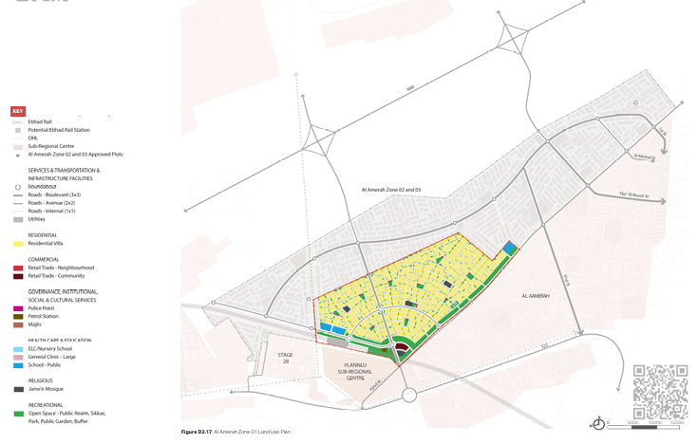
ROADMAP TO INFRASTRUCTURE APPROVAL
Securing individual agency NOCs is a strict prerequisite before initiating the final clash-free composite utility coordination drawing required by DMT.
Phase-Driven Execution

Slide 10
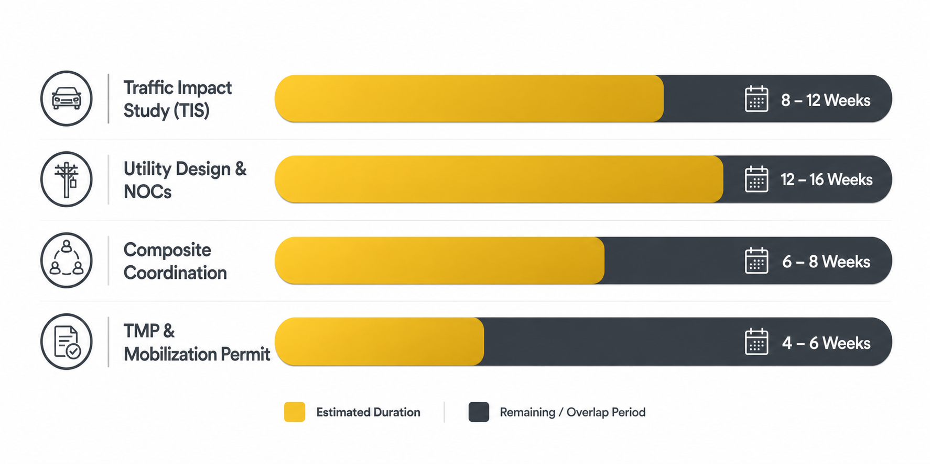
CRITICAL APPROVAL LEAD TIMES & BOTTLENECKS

Slide 11



PRIMARY AUTHORITY REQUIREMENTS
Non-negotiable precondition. Proceeding to geometric road design before TIS approval freezes trip generation risks severe redesign costs.
Internal stormwater runoff calculations must precisely match external authority network limits to prevent downstream flooding and rejections.
Rigorous spatial coordination is mandatory. Individual NOCs are invalid if utility lines overlap within shared corridor envelopes.
Early TIS Approval
Discharge Matching
Discharge Matching

Slide 12


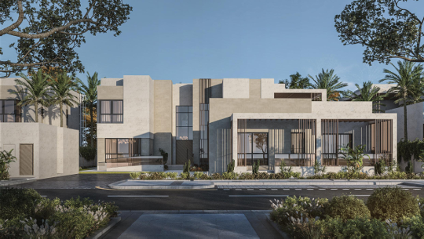

THE 10-STEP INTEGRATED CRITICAL PATH
Steps 1 - 3
Steps 4 - 6
Steps 7 - 8
Steps 9 - 10
Pre-Coordination & Baseline Data
Traffic Impact Study (TIS)
ADM TMP & Mobilization Permit
Stormwater Hydraulic Study
Irrigation & TSE Network Design
Power & Electrical Substation Allocation
Potable Water Pressure Analysis
Telecom Duct Bank Layout
Individual Utility NOC Issuance
Composite Clash-Free Drawing
DMT Final Infrastructure Approval
As-Built Clearance & Handover

Slide 13
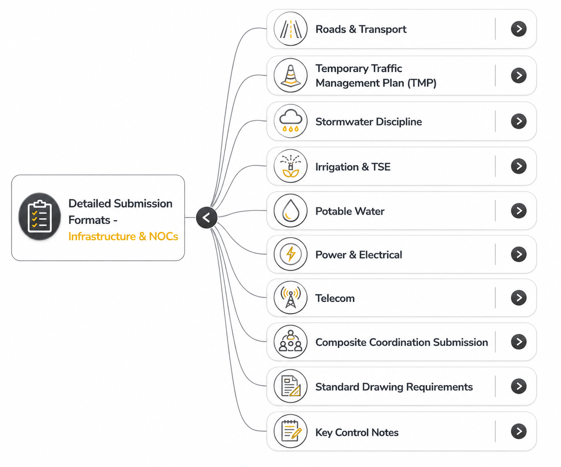
MASTERPLAN INFRASTRUCTURE WORKFLOW MIND MAP
The entire workflow spans from initial baseline data gathering and Masterplan reference to individual utility NOCs and final DMT sign-off.
Phase 1: (Pre-coordination),( TIS, and Traffic planning)
Phase 2: (Parallel discipline designs (Storm, TSE, Water, Power, Telecom)
Phase 3: (TMP and site mobilization permit)
Phase 4: (Composite clash resolution and final handover)

Slide 14
GENERAL REQUIREMENTS AND CONDITIONS
Approvals and No Objection Certificates (NOCs)
The developer or owner must obtain (NOCs) from relevant service providers, including TAQA Distribution Company, Etisalat, Du, MCC, and Al Ain City Municipality, prior to commencing any construction.
A specific NOC must be obtained from TAQA Company regarding the location of the main electricity substation, and the applicant must fulfill the conditions stated in the Department's letter (dated March 31, 2026).
The applicant must secure EAD final approval from the Environment Agency - Abu Dhabi.
Approval from the (ITC) - (TMP) is required for the project, and a copy must be submitted to the Department.
Design and Infrastructure Guidelines
The applicant must provide a dedicated bicycle track that connects to the internal street network and community facilities.
All manuals, policies, and standards of the (ITC) must be strictly followed, including those for community facilities and limited-income housing.
The applicant is required to submit Design Criteria Reports (DCRs) for commercial, community, and non-VR residential plots to the Department for review and approval.
Plan Amendments
If conditions from the NOCs or the approved transport plans conflict with the Detailed Master Plan, the developer must submit an amended application to the Department for planning review and approval.

Slide 15
BUILDING PERMIT STRATEGY
ABU DHABI MUNUCIPALITY (ADM)

Slide 16




PERMITTING STRATEGY
Client assign Consultant
Consultant apply on MEPS System (ADM System) through TAMM to obtain Approval on Building Permit
Contractor issue the Building Permit from MEPS System .
Consultant Prepare Documents for permitting strategy
Consultant appoint on the system Contractor and Site Supervision Consultant after receiving approval on Building Permit

Slide 17
PERMITTING FLOW CHART
Step 01 - Project Registration on MEPS Portal
Step 02 –
Site Clearance
Step 03A–Mandatory & Preparatory Approvals
Step 03B – Other Preparatory Approvals
Step 04 –
Full Building Permit
Step 05 – Appointing Contractor and Site Supervision Consultant
Valid Affection Plan Obtained by Client
Letter of Appointment in DMT Template Signed by Client
DMT Approval if Available
NOCs can be requested by either the consultant or by the contractor, with or without a project, in order to obtain site approvals.
Note: Site clearance can be skipped if the project governmental owned and DMT approval is obtained
Note: Mandatory list is automatically generated by the MEPS portal according to the location of the plot.
Du-Telecom
Architecture / Scope of worksheet
Contractor Valid Trade License
Site Supervision valid Trade License
Cost and Project Duration as per the project Contract
Etisalat-Telcom
Structure / Drawings + Calculation + Soil Report +Models + Building Index form
Abu Dhabi Monitoring and Control Centre – ADMCC
ADCD- Abu Dhabi Civil Defense
Third Party Structure
Integrated Traffic Centre - Traffic Studies
ADDC - LDN
Development Projects – Key Requirements to Be Obtained in Advance, as They Will Be Required During the Building Permit Approval Process
Approved Detail Master Plan (DMP)
Approved Development Control Regulations (DCR)
ENOC – Infrastructure Approvals / NOCs (ETISALAT&TAQA)
ITC Approval
EAD Approval – Environmental approval
Any other Master Development Authority NOCs/Approvals stipulated in the approved Master Plan or project conditions.
ITC - Integrated Traffic Centre
ADDC – LDN
ADM Mechanical
Step 02B –
Soil Work Permit
EAD- Environment Agency Abu Dhabi
ADDC – Potable & Recycled Water
Note: New regulation for ADDC review potable and recycled water during the shop drawing.
Soil Report Approval
Note: New Regulation MEPS Portal do not allow to apply for new soil work permit except when site clearance is fully approved.
Estidama
Note: The Estidama Consultant shall submit the Estidama application and provide us with the required documents to upload to our system.
TABREED – District Cooling
ADM Plumbing
ADSSC –Abu Dhabi Sewerage Service Company

Slide 18

GENERAL NOTES
Dorsch Gruppe – Middle East have no control on the authority requirement and identified the required supporting documents/drawings to support the approval process based on our expertise dealing with other similar projects .
External Authorities will be defined in accordance to plot location.
Site plan Should be valid
The permitting process duration varies and depends on several factors.
It is primarily influenced by the response time of the relevant authorities, as there is no fixed or predefined timeline for obtaining approvals.
The process also depends on the type of project, the mandatory site plan approvals required, and the ADM reviewer handling the application.

Slide 19
THANK YOU

Slide 20



Slide 21



